Slide 1
AIRLINE PASSENGERS SATISFACTION ANALYSIS
BY,
Nivetha

Slide 2
About Data set :
The data set about Airline passengers satisfaction Data
CSV Format Data
The Data set contains 25 columns, 5 columns were nvarchar(255), other columns were float
Steps Followed :
1.Data Collection
2. Data Cleaning
3. Data Transformation
4. Data Analysis
5. Data Visualization

Slide 3
Insights
Total Passengers 130k
Satisfied Passengers 43%
Dissatisfied or Neutral 57%
Class Wise
Business class passengers 48%
Economy Class Passengers 45%
Economy Plus class Passengers 7%

Slide 4
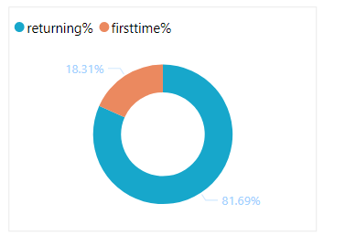
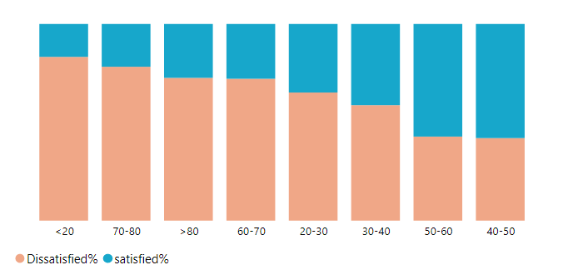
Customer Type Wise
82% of Passengers were Returning
18% of Passengers were First time
Which Age Group of Passengers were Dissatisfied or Neutral Most ?
<20 Age group of Passengers were Dissatisfied or Neutral Most
Second Most Dissatisfied or Neutral Passengers from 70-80 Age Group

Slide 5
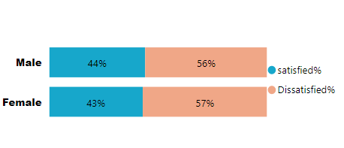
Which Age Group of Passengers were satisfied Most ?
40-50 age group of Passengers were satisfied Most
Second highest 50-60 age group of Passengers were satisfied Most
Gender Wise
Gender wise Male passengers were satisfied high
Female passengers were dissatisfied high

Slide 6
Service Rating wise :
Average of Gate Location Service 2.98
Average of Online Booking Service 2.76
Average of Inflight-wifi service 2.73
Gate Location Service, Online Booking Service , Inflight-wifi service These are the services need more improvement.
In economy class Online-Boarding average service rating 2.81 , over all average service is 3.25

Slide 7
Improvements needs to be done
In-flight Wifi Service , Online Booking , Gate Location Service needs more improvement and online board service as well
In returning customer type only get the highest satisfaction rate,
First -time customers get the high dissatisfaction rate in Economy plus class in 30-40 age group passengers
Economy class customers are the highest dissatisfaction rate, so need to improve the econonmy class services.
Majority of Dissatisfaction Passengers age group <20
Second highest Dissatisfaction Passengers age group between 70-80

